Slide 1
Email Spam Detection
Presented by – Sarna Karandeep Singh
Proposed Guided by – Proff. Soniya Jain

Slide 2
1. Introduction
Importance of Email and Spam Issues
Email has become one of the primary means of communication globally, offering fast and efficient exchange of information for business, education, and personal use.
However, with the rise in email usage, there is also a massive growth of spam emails, which are unsolicited, irrelevant, and often harmful.
Spam emails waste bandwidth, storage, processing power, and often contain malware or phishing links.

Slide 3
1. Introduction
Need for Spam Detection
According to recent studies, more than 50% of daily emails are spam.
Traditional manual filtering is time-consuming and error-prone.
Machine Learning (ML) provides automatic, adaptive, and accurate methods for detecting spam.
Effective spam detection enhances cybersecurity, protects user data, and improves email system performance.

Slide 4
2. Purpose
Project Purpose
Goal: To build a machine learning model capable of accurately predicting spam emails.
Approach: Use different ML techniques like Logistic Regression, Naïve Bayes, Random Forest, and Neural Networks.
Dataset: Public datasets (like Ling-Spam, SpamAssassin, Kaggle Datasets) are used for training and evaluation.

Slide 5
2. Purpose
Importance of the Study
Reducing spam emails saves time, cost, and resources for individuals and organizations.
Helps in detecting phishing attacks and preventing information theft.
Improves email system efficiency and user experience.

Slide 6
2. Purpose
Motivation for Machine Learning Approach
Traditional rule-based filtering techniques are static and easily bypassed by modern spammers.
Machine learning models can adapt and learn from new types of spam patterns dynamically.
Deep learning methods like BERT, LSTM, and CNN have shown high accuracy (up to 99%) in recent research.

Slide 7
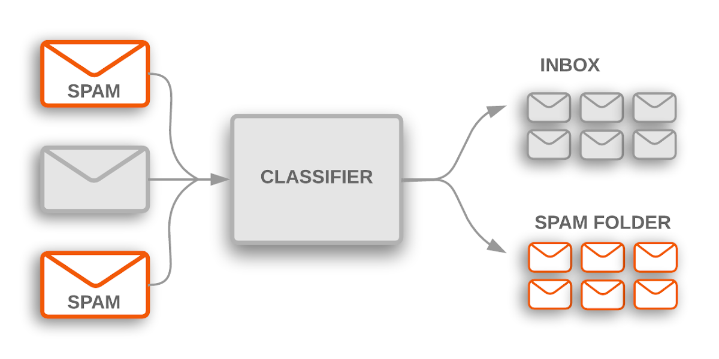

Slide 8
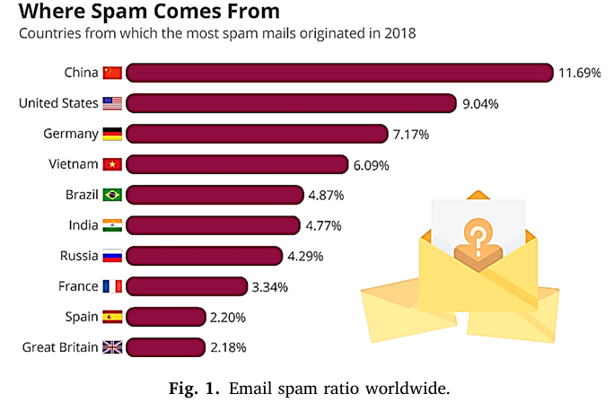

Slide 9
3. Literature Review
Paper 1
Paper Title: Email spam detection by deep learning models using novel feature selection technique and BERT
Authors: Ghazala Nasreen, Muhammad Murad Khan, Muhammad Younus, Bushra Zafar, Muhammad Kashif Hanif
Year: 2024
Journal: Egyptian Informatics Journal
Summary: This study combines Grey Wolf Optimization (GWO) for feature selection with BERT embeddings to improve spam detection. It highlights the strengths of using advanced embeddings over traditional methods. The deep learning models like CNN, LSTM, and biLSTM are integrated to boost performance.

Slide 10
Proposed Methodology: First, feature selection is carried out using GWO. Then, BERT is applied to extract rich semantic embeddings. These embeddings are fed into deep learning models for classification.
Research Gaps: Previous works lacked hybrid models combining optimization and deep learning. Traditional ML models dominated the field.
Results: Achieved a remarkable 99.14% accuracy on the Ling-Spam dataset, outperforming baseline models.

Slide 11
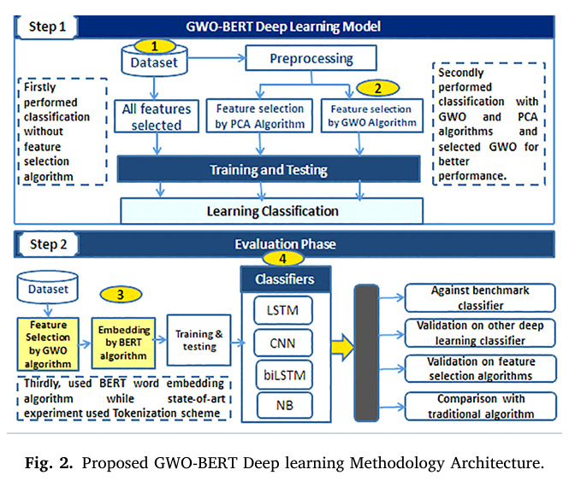

Slide 12
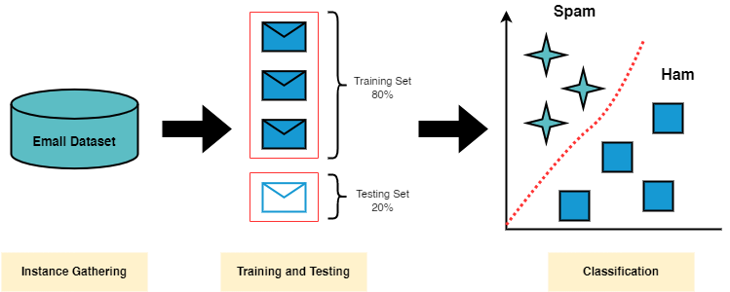

Slide 13
3. Literature Review
Paper 2
Paper Title: Email Spam Detection using Machine Learning
Authors: Dr. Nilesh Jain, Dr. B.K. Sharma
Year: 2025
Journal: International Journal of Mechanical Engineering
Summary: The paper discusses basic machine learning classifiers for spam detection and highlights their effectiveness. Emphasis is placed on comparing models like Naïve Bayes, SVM, and Neural Networks.

Slide 14
Proposed Methodology: Email content was extracted and cleaned. Models like Naïve Bayes and SVM were applied to classify the emails.
Research Gaps: Usage of small datasets; absence of ensemble and advanced feature selection methods.
Results: Neural Networks provided the best results with approximately 98.8% accuracy.

Slide 15
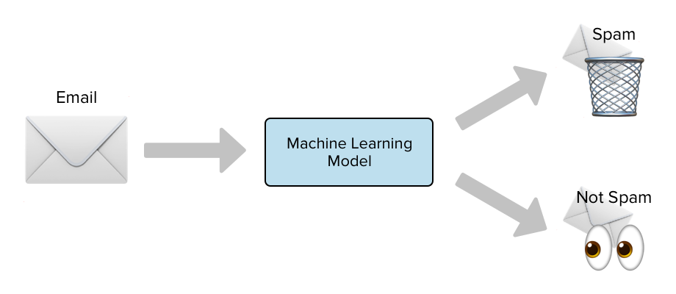

Slide 16
3. Literature Review
Paper 3
Paper Title: Email Spam Detection Using Machine Learning Algorithms
Authors: Nikhil Kumar, Sanket Sonowal, Nishant
Year: 2020
Journal: Proceedings of ICIRCA-2020 (IEEE)
Summary: A detailed study on applying multiple machine learning algorithms to detect spam. The study compared different models based on precision, recall, and accuracy.

Slide 17
Proposed Methodology: Preprocessing techniques were used to clean and vectorize the data, followed by training and evaluating Naïve Bayes, Random Forest, and SVM classifiers.
Research Gaps: No integration of deep learning techniques; dependency on classic ML models.
Results: Random Forest and Naïve Bayes models gave the highest precision and recall scores.

Slide 18
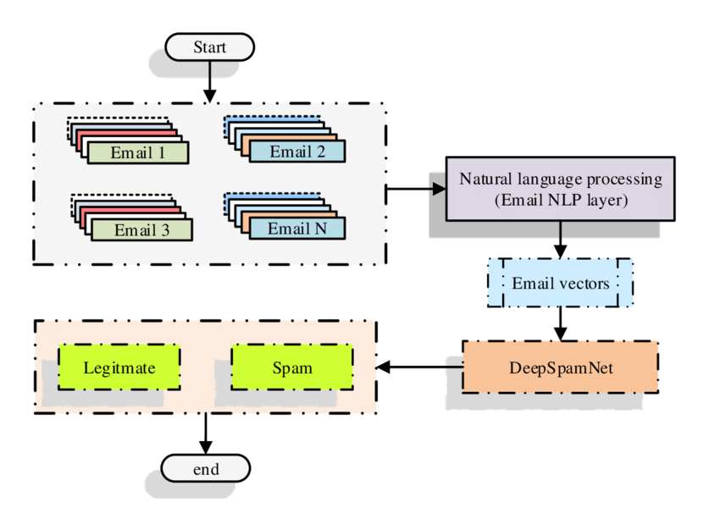

Slide 19
3. Literature Review
Paper 4
Paper Title: Advancing Email Spam Classification using Machine Learning and Deep Learning Techniques
Authors: Meaad Hamad Alsuwit, Mohd Anul Haq, Mohammed A. Aleisa
Year: 2024
Journal: Engineering, Technology & Applied Science Research (ETASR)
Summary: The paper combined traditional machine learning models and Artificial Neural Networks to classify emails as spam or ham. It focused on improving accuracy through hybrid approaches.

Slide 20
Proposed Methodology: Logistic Regression, Naïve Bayes, Random Forest, and ANN models were built using a merged TREC and Enron dataset.
Research Gaps: Future improvements proposed involve ensemble techniques like XGBoost and handling adversarial attacks.
Results: ANN model achieved the highest performance with 98% accuracy and an F1 score of 97.5%.

Slide 21
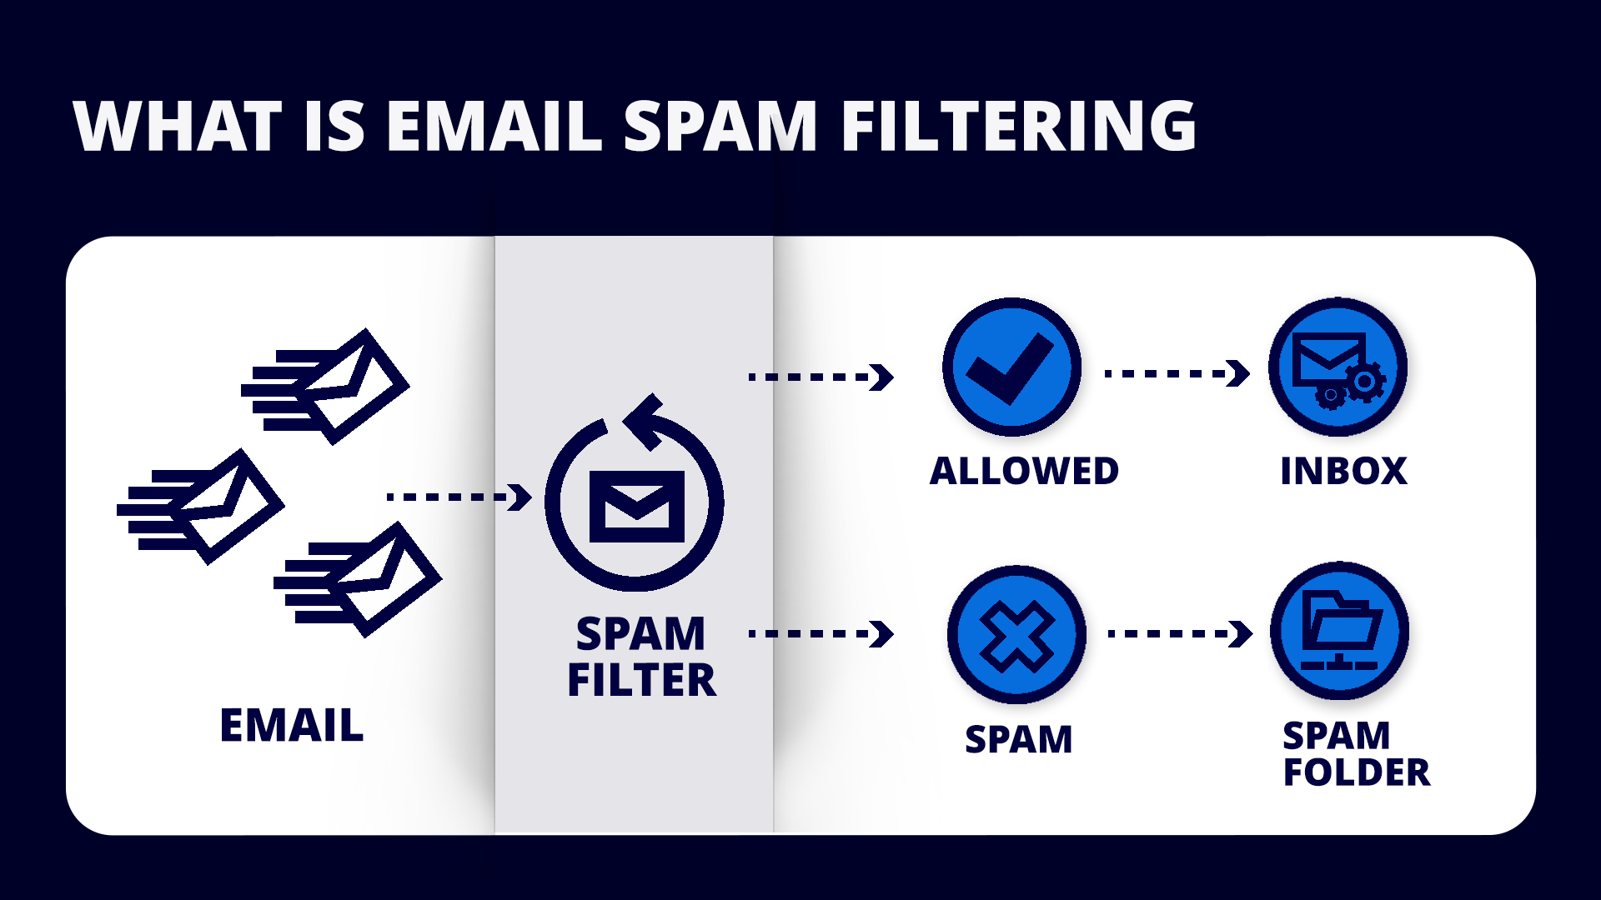

Slide 22
3. Literature Review
Paper 5
Paper Title: Email Spam Detection Using Logistic Regression
Authors: Manu Garg, Parveen, Muskan Gupta, Ojasvi
Year: 2022
Journal: Journal of Pharmaceutical Negative Results
Summary: Focused purely on using Logistic Regression for spam detection, emphasizing simplicity and effectiveness.

Slide 23
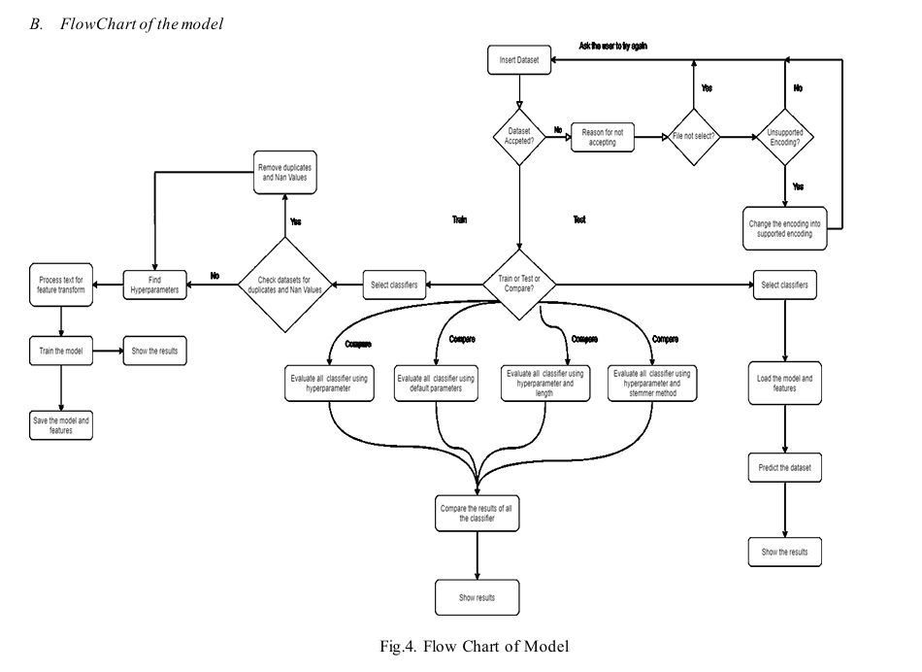

Slide 24
Proposed Methodology: Applied Logistic Regression on Kaggle spam datasets after standard preprocessing.
Research Gaps: No hybrid or ensemble techniques explored; dependency on a single model.
Results: Achieved about 98% accuracy but noted concerns about adaptability and generalization to newer datasets.

Slide 25
4. Literature Survey
No. | Paper Title | Paper Details | Inference
1 | Email spam detection by deep learning models using BERT | 2024, Egyptian Informatics Journal | GWO-BERT achieved highest accuracy (99.14%) using hybrid DL techniques
2 | Email Spam Detection using Machine Learning | 2022, IJME | Traditional ML models effective; Neural Networks best at 98.8%
3 | Email Spam Detection Using Machine Learning Algorithms | 2020, IEEE ICIRCA | Random Forest and Naïve Bayes gave high performance
No.

Slide 26
4. Literature Survey
No. | Paper Title | Paper Details | Inference
4 | Advancing Email Spam Classification using ML and DL | 2024, ETASR | ANN outperformed other models; emphasized combining ML and DL
5 | Email Spam Detection Using Logistic Regression | 2022, JPNR | Logistic Regression alone achieved high accuracy (~98%) but lacks robustness
No.

Slide 27
5. Research gaps
Lack of hybrid models combining optimization techniques with deep learning.
Limited handling of adversarial attacks (spams disguised as genuine emails).
Focus mainly on English datasets, no multilingual spam detection explored.
Few studies address real-time filtering and computational efficiency simultaneously.

Slide 28
6. Problem Statement
"To design a machine learning model that accurately predicts spam emails while reducing false positives, using an efficient and hybrid approach combining advanced feature selection and classification techniques."

Slide 29
7. Research Objectives
To implement and compare multiple ML models for email spam detection.
To increase classification accuracy and reduce computational costs.
To explore feature selection techniques for improving model performance.
To propose a hybrid model for real-world spam filtering needs.

Slide 30
8. Tentative Proposed Methodology
Data Collection: Kaggle Email Spam dataset.
Preprocessing: Data cleaning, tokenization, stopword removal.
Feature Extraction: TF-IDF, Word Embeddings (BERT optional).
Model Building: Logistic Regression, Naïve Bayes, Random Forest, Neural Network.
Optimization: Hyperparameter tuning using Grid Search.
Evaluation: Confusion matrix, accuracy, precision, recall, F1-Score.

Slide 31
9. Implementation Environment
Programming Language: Python 3.10
Libraries:
Scikit-learn
Pandas
NumPy
TensorFlow/Keras (for deep learning models)
IDE: Jupyter Notebook / VS Code
Hardware: Laptop/PC with 8GB+ RAM, 4-core CPU

Slide 32
10. Evaluation Criteria
Accuracy
Precision
Recall
F1 Score
ROC-AUC Curve
(Comparison between models based on these metrics.)

Slide 33
11. Conclusion
Spam email detection is a critical challenge due to its rapid evolution.
Machine learning offers dynamic solutions that outperform traditional filtering.
The proposed work focuses on creating a hybrid model with high accuracy and low false positives.
Future work can explore real-time detection, multilingual spam, and adversarial robustness.

Slide 34
12. References
Nasreen, G., Khan, M.M., Younus, M., Zafar, B., Hanif, M.K. (2024). Email spam detection by deep learning
models using novel feature selection technique and BERT. Egyptian Informatics Journal.
Jain, N., Sharma, B.K. (2022). Email Spam Detection using Machine Learning. International Journal of
Mechanical Engineering.
Kumar, N., Sonowal, S., Nishant (2020). Email Spam Detection Using Machine Learning Algorithms.
IEEE ICIRCA 2020.
Alsuwit, M.H., Haq, M.A., Aleisa, M.A. (2024). Advancing Email Spam Classification using Machine
Learning and Deep Learning Techniques. ETASR.
Garg, M., Parveen, Gupta, M., Ojasvi (2022). Email Spam Detection Using Logistic Regression.
Journal of Pharmaceutical Negative Results.

Slide 35
Thank You

